Slide 1
Esoteric Programming Languages
Jason Bock

Slide 2
Personal Info
http://www.jasonbock.net
https://www.twitter.com/jasonbock
https://www.github.com/jasonbock
jason.r.bock@outlook.com

Slide 3
Downloads
https://github.com/JasonBock/IronBefunge
https://github.com/JasonBock/wsharp
https://github.com/JasonBock/Presentations/blob/master/Esoteric%20Programming%20Languages.pptx

Slide 4
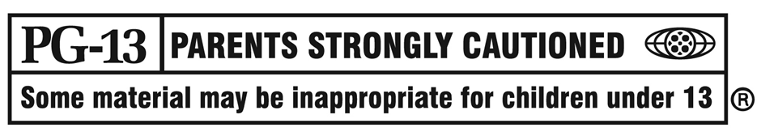
WARNING!
Notes:
There’s one language in this talk that will be censored, but…it has a “bad” word in it. So … just so you know ☺.

Slide 5
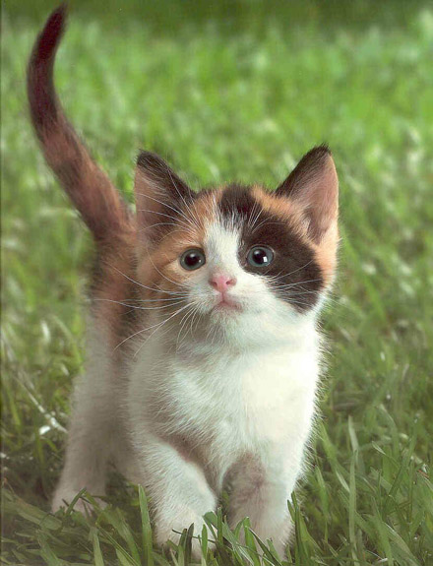
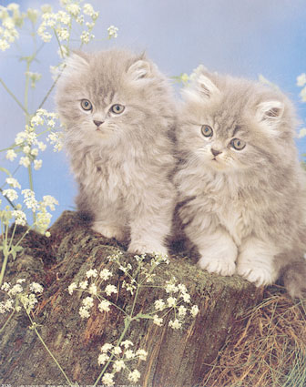
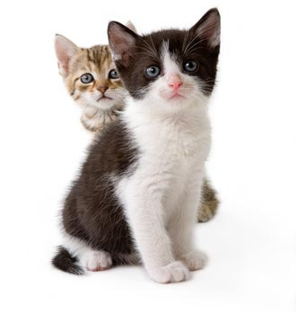
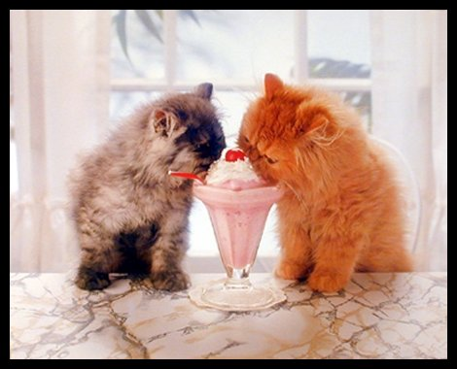

Cute Kittens
Notes:
If that word offends you, just think of cute kittens.

Slide 6
Why?
“Designing bizarre languages like this is a hobby. The point isn't to create something useful, but to create something that is deeply bizarre, and yet somehow compelling.”
http://scienceblogs.com/goodmath/2006/07/friday_pathological_programmin_1.php#comment-180935
Notes:
What’s the point of spending any time exploring esoteric languages? Well, it’s fun. It’s also artistic in a way. It’s a way to just do something different in the world of software development.

Slide 7

Definition
http://fc02.deviantart.net/fs21/f/2007/246/e/0/Esoteric_Hues_by_cityofthemolepeople.jpg
Notes:
Trying to define what “esoteric” is, is not an easy endeavor as it’s somewhat subjective.

Slide 8
Definition
esoteric (ˌɛsəʊˈtɛrɪk)
— adj
1. restricted to or intended for an enlightened or initiated minority, esp. because of abstruseness or obscurity: an esoteric cult
2. difficult to understand; abstruse: an esoteric statement
3. not openly admitted; private: esoteric aims
http://dictionary.reference.com/browse/esoteric
Notes:
I like the use of “enlightened or initiated minority” and “difficult to understand”

Slide 9
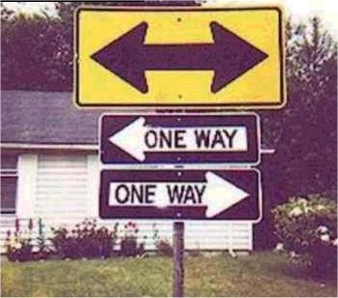
State of Affairs
http://www.jokesandhumor.com/jokes/pictures/confusion.jpg
Notes:
If you dive into the world of EPLs, beware. Documentation is light or non-existent, compilers/interpreters may not work as expected. Etc.

Slide 10
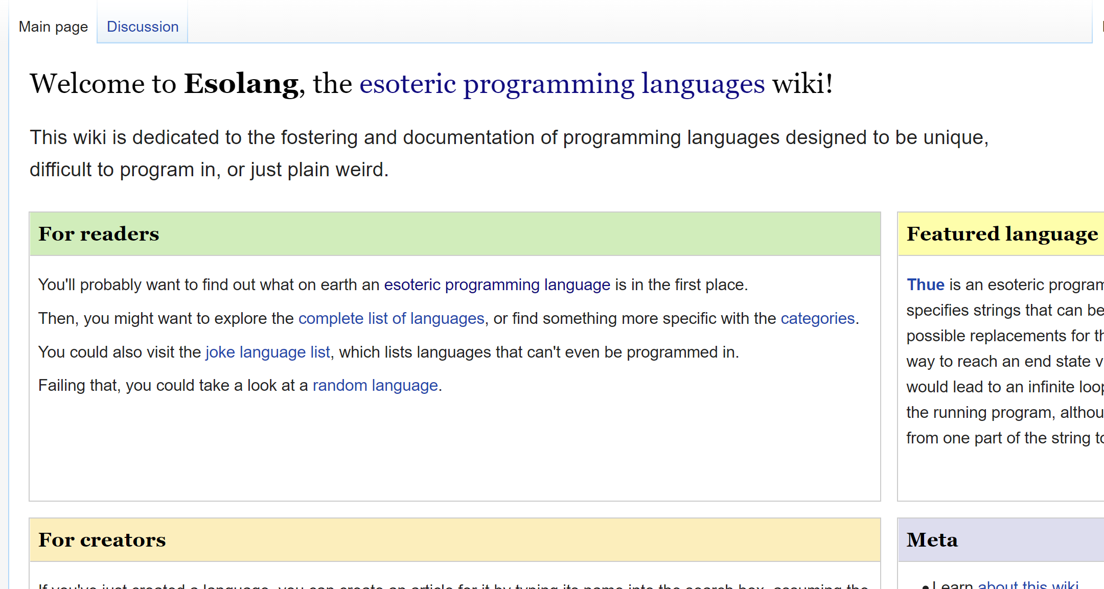
State of Affairs
https://esolangs.org/wiki/Main_Page
Notes:
Here’s the best resource to find out information on everything esoteric programming language related.

Slide 11
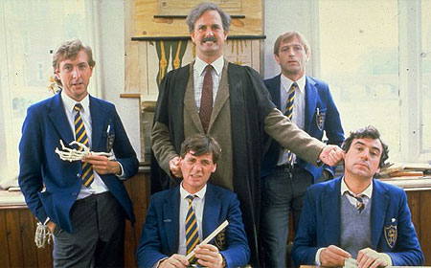
INTERCAL
http://webpublicapress.net/wp-content/uploads/2011/12/monty-python-2.jpg

Slide 12
INTERCAL
“INTERCAL, an abbreviation for Compiler Language With No Pronouncable Acronym, was created in 1972, thus probably making it the first ever esoteric programming language.”
http://esolangs.org/wiki/INTERCAL

Slide 13
INTERCAL
Commands
DON’T
DO NOT
PLEASE DON’T
PLEASE DO NOT
COME FROM
ABSTAIN
1/3 to 1/5 of the commands must be polite
http://esolangs.org/wiki/INTERCAL
Notes:
Note the range of polite commands

Slide 14
INTERCAL
Error Messages
E632 THE NEXT STACK RUPTURES. ALL DIE. OH, THE EMBARRASSMENT!
E990 YOU HAVE TOO MUCH ROPE TO HANG YOURSELF
E333 YOU CAN'T HAVE EVERYTHING, WHERE WOULD YOU PUT IT?
E111 COMMUNIST PLOT DETECTED, COMPILER IS SUICIDING
E774 RANDOM COMPILER BUG
http://esolangs.org/wiki/INTERCAL
Notes:
The error messages are priceless

Slide 15
INTERCAL
Hello World
--------------------------------------------------------------->8---
PLEASE NOTE THAT THIS MAY ONLY RUN ON C-INTERCAL
PLEASE DO ,1 <- #13
DO ,1 SUB #1 <- #238
DO ,1 SUB #2 <- #112
DO ,1 SUB #3 <- #112
DO ,1 SUB #4 <- #0
DO ,1 SUB #5 <- #64
DO ,1 SUB #6 <- #238
DO ,1 SUB #7 <- #26
DO ,1 SUB #8 <- #248
DO ,1 SUB #9 <- #168
DO ,1 SUB #10 <- #24
DO ,1 SUB #11 <- #16
DO ,1 SUB #12 <- #158
DO ,1 SUB #13 <- #52
PLEASE READ OUT ,1
PLEASE GIVE UP
--------------------------------------------------------------->8---
http://esolangs.org/wiki/INTERCAL
Notes:
I’ll trust that this actually does what it’s supposed to do

Slide 16

Brainf**k
http://oddstuff.in/wp-content/uploads/2011/02/86-300x280.jpg
Notes:
BF will literally do that to your brain.

Slide 17
Brainf**k
“Many people at various times have tried to extend brainf**k to make it easier to program in, but such efforts have been compared to trying to make a luxury car by gluing parts onto a skateboard.”
http://bit.ly/QQlMPR

Slide 18

Brainf**k
http://coolmaterial.com/wp-content/uploads/2008/07/ferrari-skateboard.jpg
Notes:
I guess that’s what that looks like

Slide 19
Brainf**k
Commands | Description
> | Move pointer to the right
< | Move pointer to the left
+ | Increment the memory cell under the pointer
- | Decrement the memory cell under the pointer
. | Output the character signified by the cell at the pointer
, | Input a character and store it in the cell at the pointer
[ | Jump past the matching ] if the cell under the pointer is 0
] | Jump back to the matching [ if the cell under the pointer is nonzero
Notes:
I guess that’s what that looks like

Slide 20
Brainf**k
++++++++[>+++++++++<-]>.
8
9
8 * 9 = 72 => 'H'
Notes:
Anyway, BF is all about a tape moving back and forth. This code prints “H”, which is the start of “Hello World”
All the plusses put 8 into the current cell.
Then ”[“ doesn’t jump to “]” because we’re at 8.
We move to the next cell with “>”, and put 9 in that cell.
We move back to the first cell with “<“, minus one, and we jump back to “]” because 7 isn’t non-zero.
We move to the 9 cell, and add 9 more.
We keep looping until the 8 cell goes down to zero, which causes “]” to move on.
“>” moves us to the “72” cell, and we print ‘H’ via “.”

Slide 21

Inspiration
https://konnikim.files.wordpress.com/2014/02/inspiration.jpg
Notes:
One interesting aspect to these esoteric languages is they’re good places to start to learn how to write your own compilers and interpreters (something I’m a newbie at myself). They can inspire you to explore programming by building these assets to get code written in a language.

Slide 22
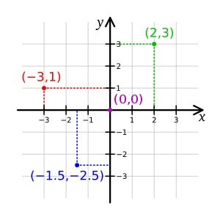
Befunge
https://upload.wikimedia.org/wikipedia/commons/thumb/0/0e/Cartesian-coordinate-system.svg/300px-Cartesian-coordinate-system.svg.png
Notes:
Befunge is an interesting language. It’s cell-based in 2D, so you move around, interpret the character at that cell, and do some kind of activity based on the value.

Slide 23
Befunge
“Befunge is a two-dimensional esoteric programming language invented in 1993 by Chris Pressey with the goal of being as difficult to compile as possible.”
http://www.esolangs.org/wiki/Befunge
Notes:
It’s almost impossible to compile Befunge code, but you can write an interpreter.

Slide 24
Befunge
Instruction(s) | Description
>, V, <, ^ | Change direction
" | Toggle string mode
0 – 9 | Push value on to stack
: | Duplicate top stack value
_ | Horizontal IF
, | Output stack value as ASCII
* | Multiply two top stack values
@ | End program
Notes:
Here are the instructions

Slide 25
Befunge
Hello World
v"Canonical hello world"
> v
>v"Hello world!"0<
,:
^_25*,@

Slide 26
Demo: IronBefunge
Esoteric Programming Languages
Notes:
Let’s take a look at IronBefunge

Slide 27

Whenever
http://farm3.static.flickr.com/2702/4490052936_38d3254c0d_z.jpg
Notes:
Whenever is a lazy language. It’s akin to sitting in a comfortable chair, and just randomly flipping channels on the TV, except in Whenever, you’re randomly executing code.

Slide 28
Whenever
“Whenever is a programming language which has no sense of urgency. It does things whenever it feels like it, not in any sequence specified by the programmer”
http://www.dangermouse.net/esoteric/whenever.html

Slide 29
Whenever
Program code lines will always be executed, eventually (unless we decide we don't want them to be), but the order in which they are executed need not bear any resemblance to the order in which they are specified.
Variables? We don't even have flow control, we don't need no steenking variables!
Data structures? You have got to be kidding.
http://www.dangermouse.net/esoteric/whenever.html
Notes:
There are no variables, data structures, etc. There’s just statements with a few control structures in place. That’s it.

Slide 30

Whenever
1 print("Hello");
2 1#2;
3 1#-1;
http://cgsva.lbbhost.com/jpgs42/grab-bag.jpg
Notes:
Essentially every line of code is thrown into a “grab bag” and executed at random. Each line of code also has a count associated with it, we’ll get to that in a moment.

Slide 31
Whenever
defer – defers execution of a statement
again – keeps a statement in the to-do list after execution
N(x) – returns the number of lines specified by x
U(x) – returns the Unicode representation of x
Notes:
There are a small handful of functions that help with bringing some sense to Whenever.

Slide 32
Whenever
99 Bottles of Beer
1 defer (4 || N(1) < N(2) && N(2) < N(3)) print(N(1) + " bottles of beer on the wall, " + N(1) + " bottles of beer,");
2 defer (4 || N(1)==N(2)) print("Take one down and pass it around,");
3 defer (4 || N(2)==N(3)) print(N(1) + " bottles of beer on the wall.");
4 1#98,2#98,3#98;
http://www.dangermouse.net/esoteric/whenever.html
Notes:
For example, this program will do 99 bottles of beer on the wall. The defer function won’t let 1, 2, or 3 run until 4 runs, and then the other half ensures 1, then 2, then 3 run 99 times

Slide 33
Whenever
Fibonacci Numbers (first 100)
1 again (1) defer (3 || N(1)<=N(2) || N(7)>99) 2#N(1),3,7;
2 again (2) defer (3 || N(2)<=N(1) || N(7)>99) 1#N(2),3,7;
3 defer (5) print(N(1)+N(2));
4 defer (5) print("1");
5 4,-3,7;
6 defer (4) 3;
7 7;
8 defer (N(7)<100) -1#N(1),-2#N(2),-7#100,-3;
9 defer (3 || 6) 1,3;
http://www.dangermouse.net/esoteric/whenever.html
Notes:
Feel free to follow the logic in this one ☺

Slide 34
Demo: WSharp
Esoteric Programming Languages
Notes:
Let’s take a look at WSharp

Slide 35

Conclusion
http://ecoopportunity.net/wp-content/uploads/2011/06/wasting-time.jpg
Notes:
At the end, this may all feel like a waste of time.

Slide 36

Conclusion
http://images.piccsy.com/cache/images/time-you-enjoy-wasting-is-not-wasted-time-96489-500-500.jpg
Notes:
But if YOU don’t feel like it was time wasted (e.g. you got something out of it) then it’s not wasted time.

Slide 37
Esoteric Programming Languages
Jason Bock
Remember…
https://github.com/JasonBock/IronBefunge
https://github.com/JasonBock/wsharp
https://github.com/JasonBock/Presentations/blob/master/Esoteric%20Programming%20Languages.pptx
Links to code and slide deck
References in the notes on this slide
Notes:
http://www.esolangs.org/wiki/Main_Page
https://devblogs.microsoft.com/visualstudio/how-to-debug-and-profile-any-exe-with-visual-studio/

